Slide 1
The Circuit Less Travelled: A Path of Gentrification Through Colorado Neighborhoods
Weston Grewe and Angela Morrison

Slide 2
The Data
5-year period aggregate survey data at the neighborhood level for the state of Colorado (2006-2010,2010-2015,2015-2019)
Columns related to gentrification:
Average income
Highest level of education
Demographic breakdown
Something to keep in mind: these variables all use different scales for their values

Slide 3
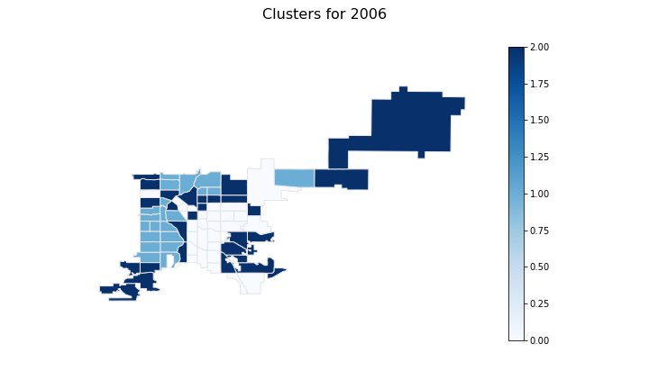
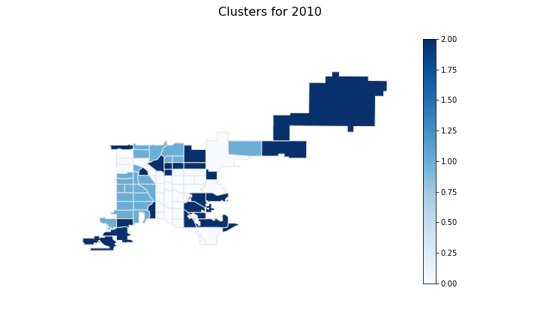

K-Means Clustering
2006
2010
2015

Slide 4
Describing the Clusters
2006
 | Cluster 1 | Cluster 2 | Cluster 3
Med Income | 54,000 | 27,000 | 15,000
% White | 79 | 53 | 21
% Hispanic | 8 | 26 | 66
% Black | 4 | 14 | 7
% College | 65 | 37 | 14
% Poverty | 4 | 15 | 29

Slide 5
Determining the Circuits
How we get the circuits:
Determine all paths and cycles
Delete duplicates
Circuit Walk
Implementing the greedy algorithm
Increasing Speed:
Separating the matrix B
No repeat visits
Determine which entries in vector already have zeros

Slide 6
Where We’re at Right Now
Circuit walks for 2006 to 2010, 2010 to 215, and 2006 to 2015
Plotting the steps for visual representation
Providing a narrative for the circuit walks
Detereming policy recommendations based on these visualisations

Slide 7
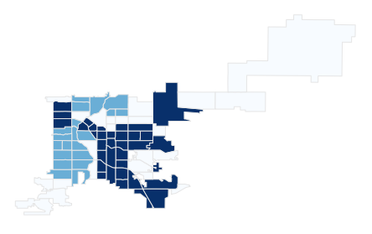
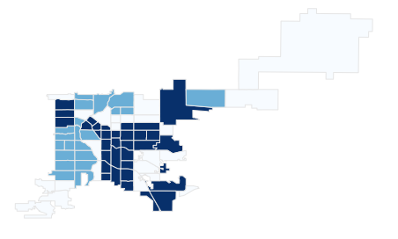

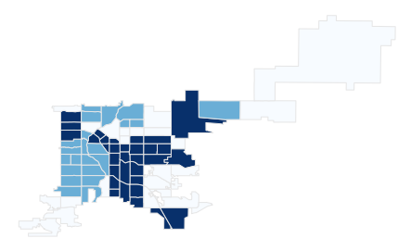
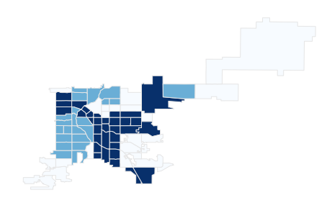

2006 to 2010 Circuit Walk
Step 1
Step 2
Step 3
Step 4
Step 5
Step 6

Slide 8
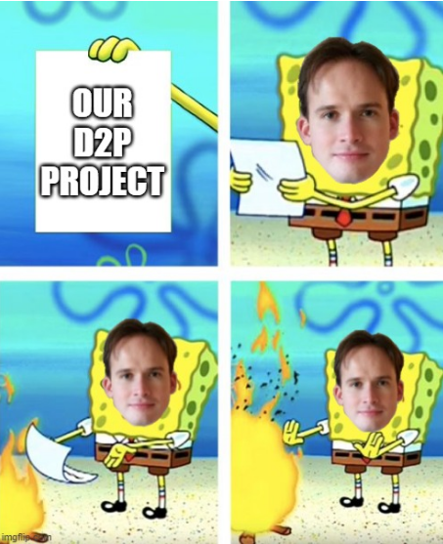
Questions?

